Slide 1
Analyzing Customer Reviews: Women’s E-Commerce Clothing
Group 05:
Hemachandar Nagarajan (hn395@drexel.edu)
Sahibzada Aasim Imtiyaz (si339@drexel.edu)
Ishita Kakar (ik372@drexel.edu)
Shailey Rai (sr3466@drexel.edu)

Slide 2
Introduction
Text mining is the process of examining large collections of text and converting the unstructured text data into structured data for further analysis like visualization and model building.
Objective:
In our analysis, we will utilize the power of text mining to do an in-depth analysis of customer reviews on an e-commerce clothing site data and build a classification model to predict whether the customer will recommend the product or not.
It will help retailers to have an understanding about their products, mistakes and customer satisfaction.

Slide 3
Dataset
We selected ‘Women’s E-Commerce Clothing Reviews’ data from Kaggle (Link)
We have a review dataset of 23,486 rows and 10 columns of data. The feature variables are:
Feature | Explanation
Clothing ID | Integer Categorical variable that refers to the specific piece being reviewed.
Age | Positive Integer variable of the reviewers age.
Title | String variable for the title of the review.
Review Text | String variable for the review body.
Rating | Positive Ordinal Integer variable for the product score granted by the customer from 1 Worst, to 5 Best.
Recommended IND | Binary variable stating where the customer recommends the product where 1 is recommended, 0 is not recommended.
Positive Feedback Count | Positive Integer documenting the number of other customers who found this review positive.
Division Name | Categorical name of the product high level division.
Department Name | Categorical name of the product department name.
Class Name | Categorical name of the product class name.

Slide 4
Methodology
Data Exploration
Exploratory Data Analysis
Bivariate Analysis
Data Pre-processing
Checking for Missing Values
Classification Model
Decision Tree Classifier
Naïve Bayes Classifier
Removing Redundant Features
Outlier Detection
Logistic Regression
SVM Classifier
Text cleaning: Word count
Sentiment Analysis
Encoding Categorical Variables
Balancing Dataset

Slide 5
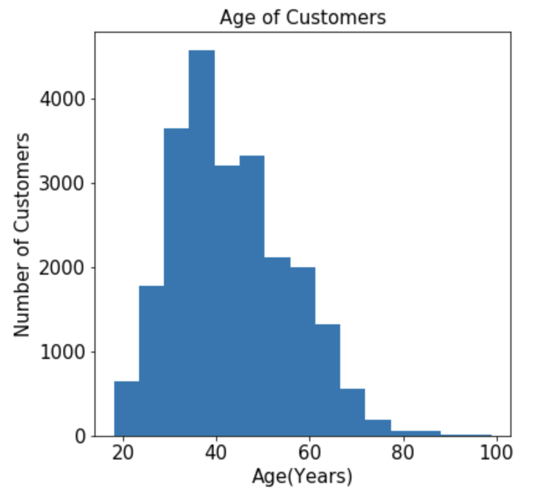
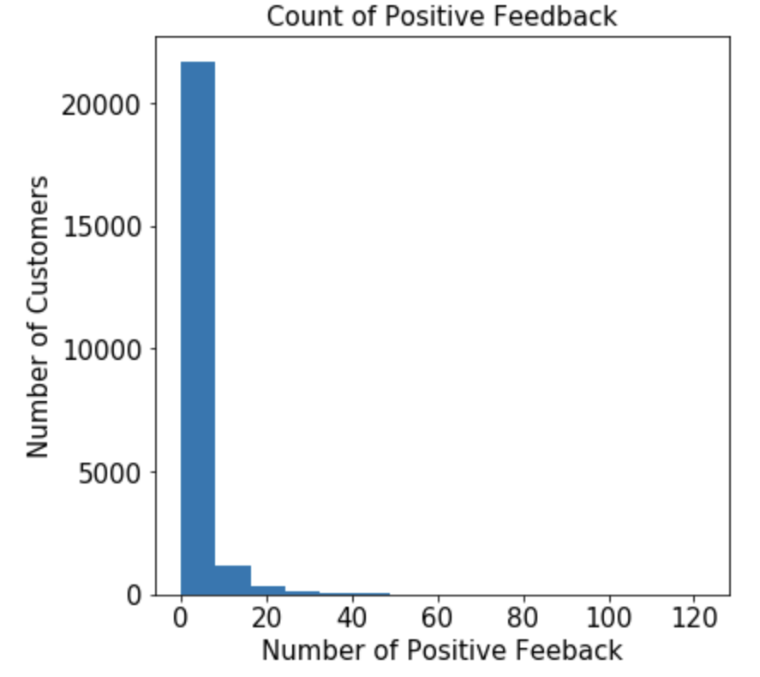
Methodology: Data Exploration
Exploratory Data Analysis
Age
Positive Feedback Count
Majority of the reviews seem to come from ages 18 to 40
Very less positive feedback count by most of the customers i.e < 20

Slide 6
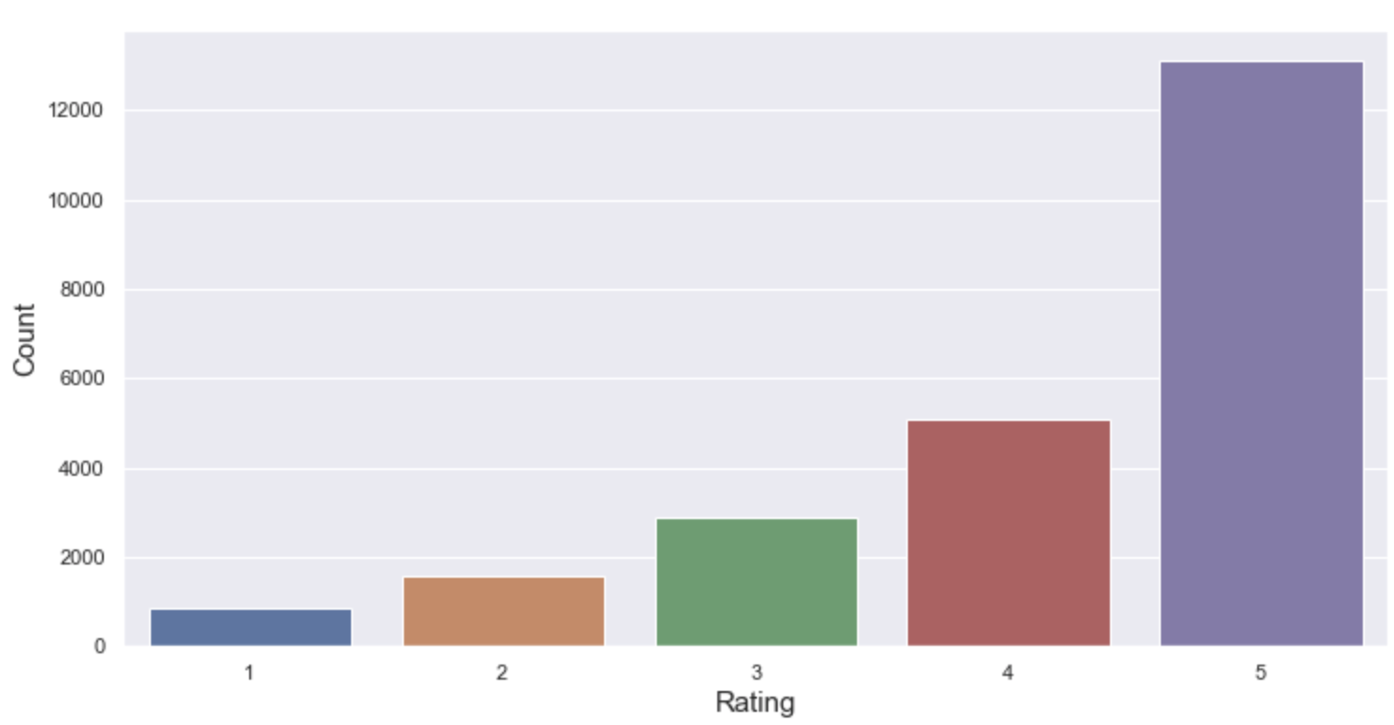
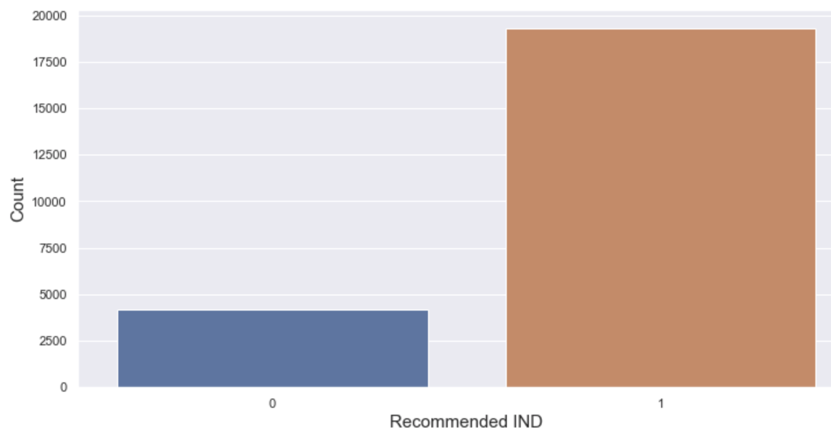
Methodology: Data Exploration
Rating
Recommended IND
1 represents that the product was recommended by the customer
Most of the customers are giving 3,4 and 5 rating for the retailer products

Slide 7
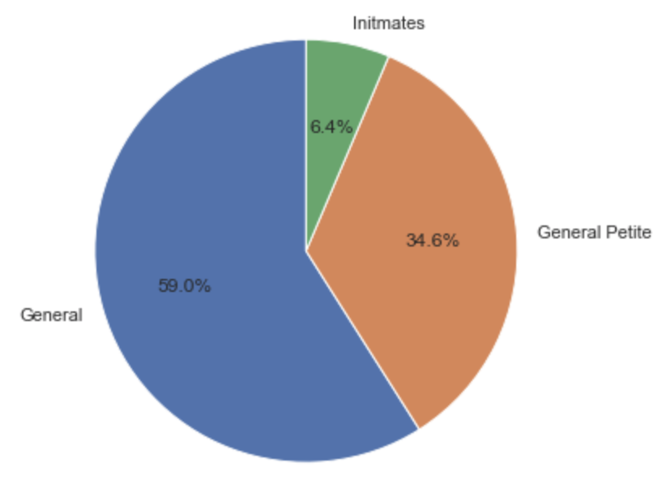
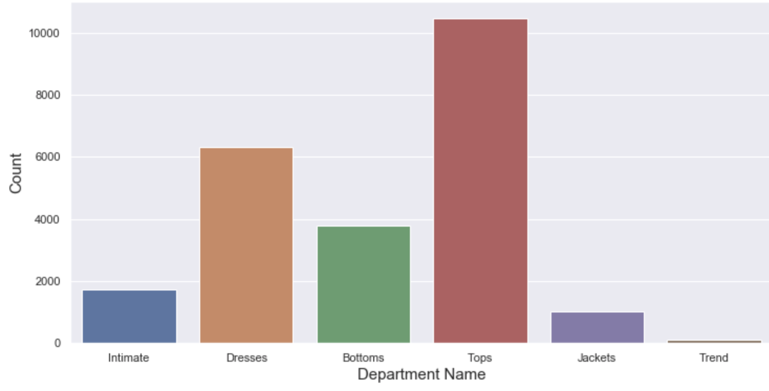
Methodology: Data Exploration
Division Name
Department Name
Most of the orders were from the ‘General’ category and least from the Intimates category
‘Tops’ and ‘Dresses’ had most of the reviews and ‘Trends’ had least number of reviews

Slide 8
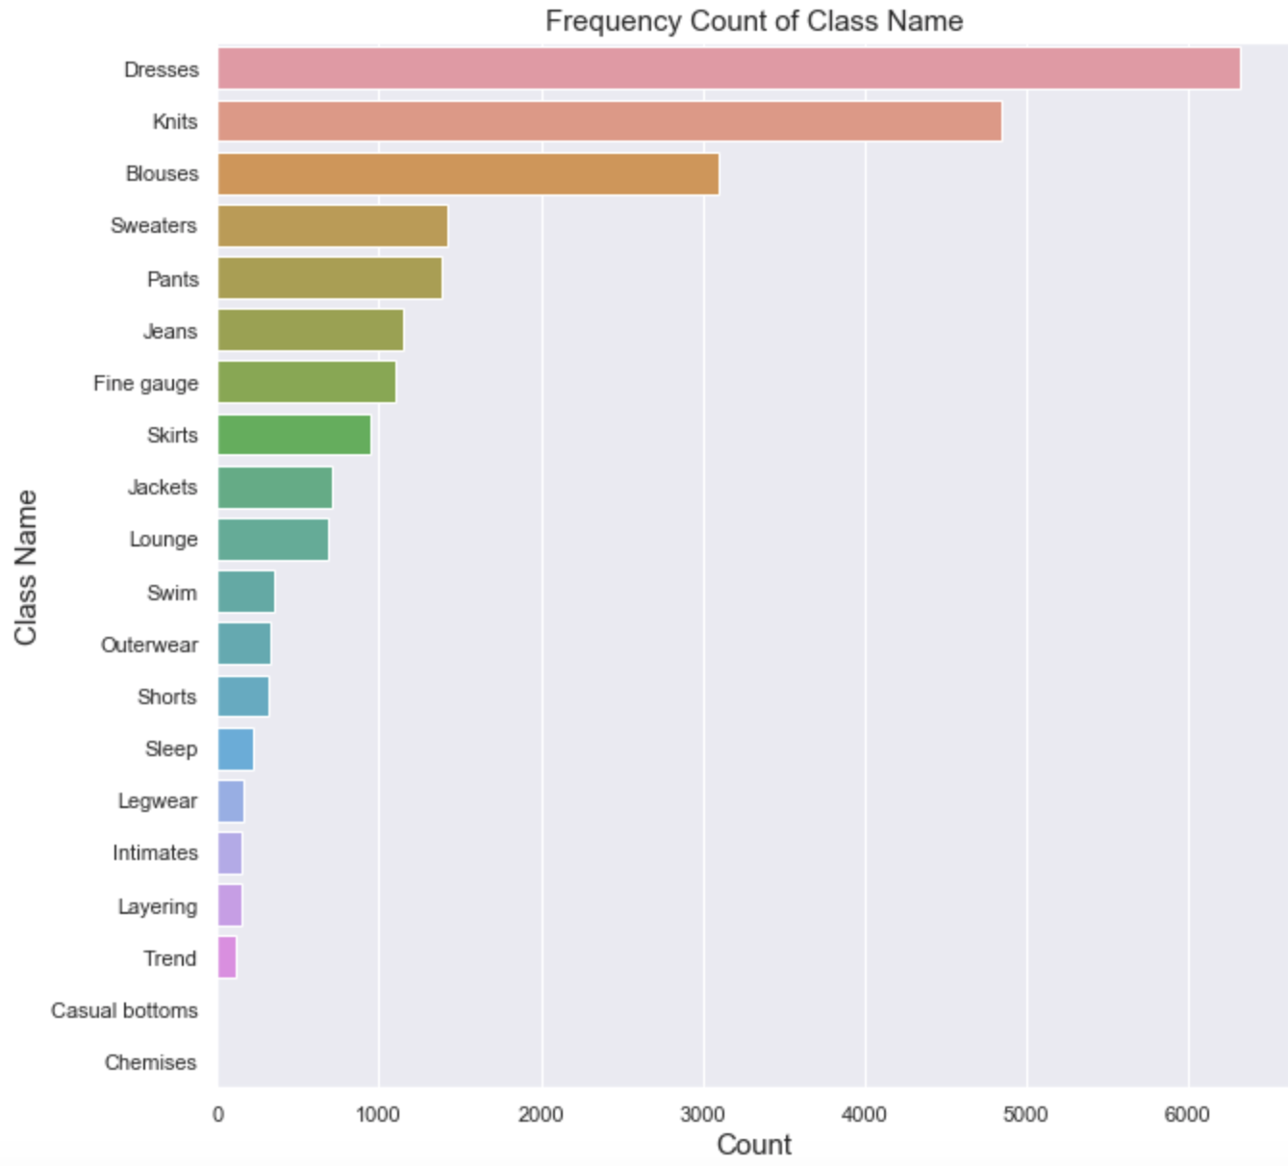
Methodology: Data Exploration
Class Name
‘Dresses’ category topped the ranks with 6,319 mentions, followed by ‘Knits’ category with 4,843 mentions

Slide 9
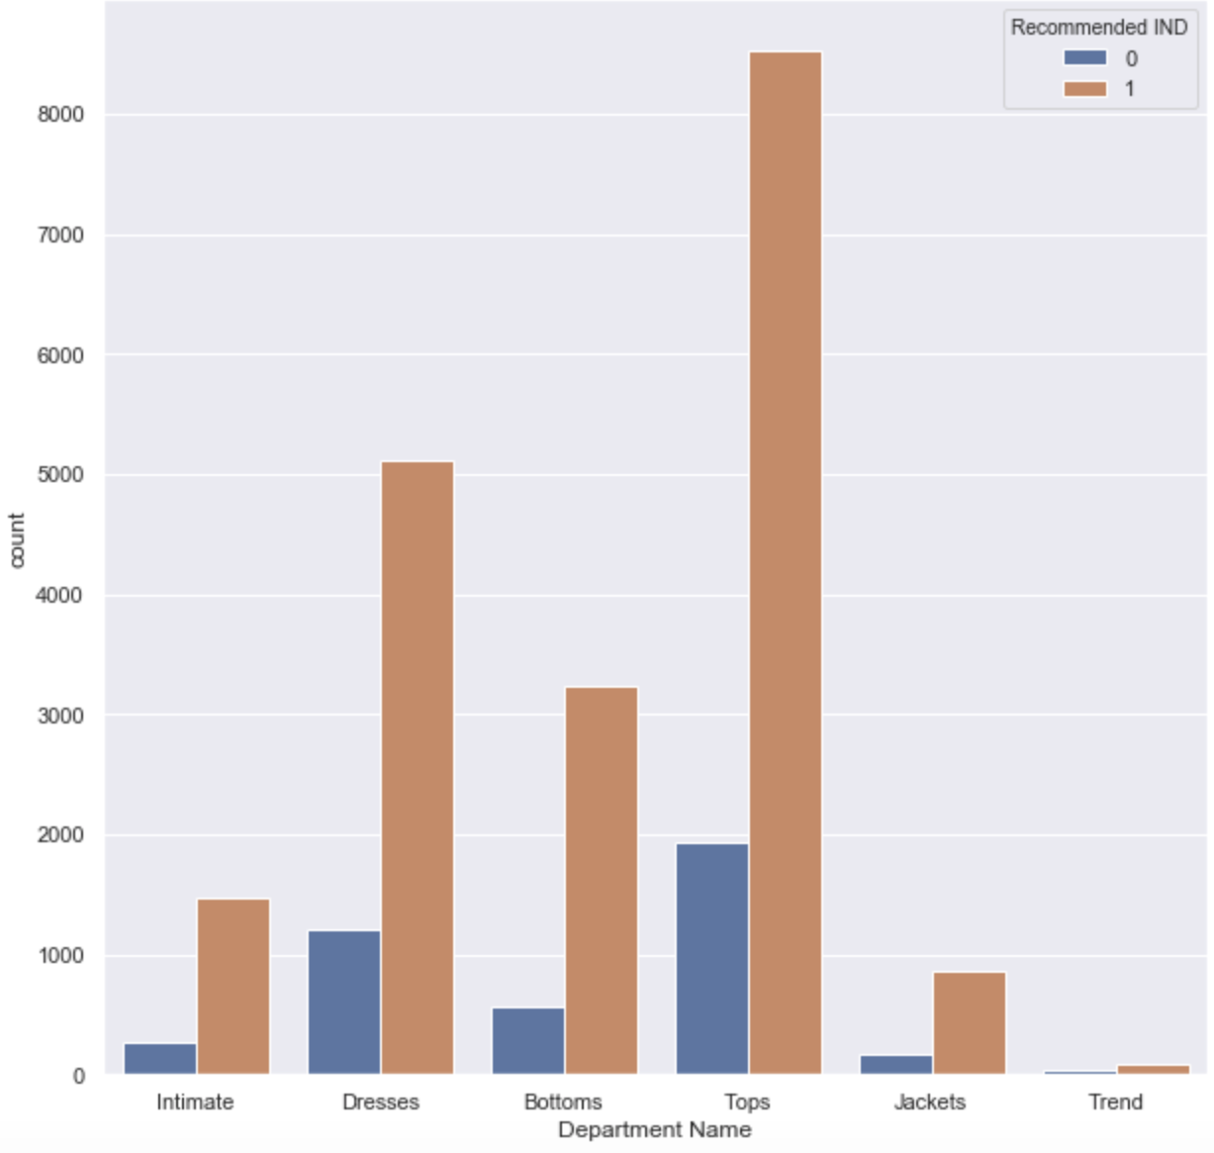
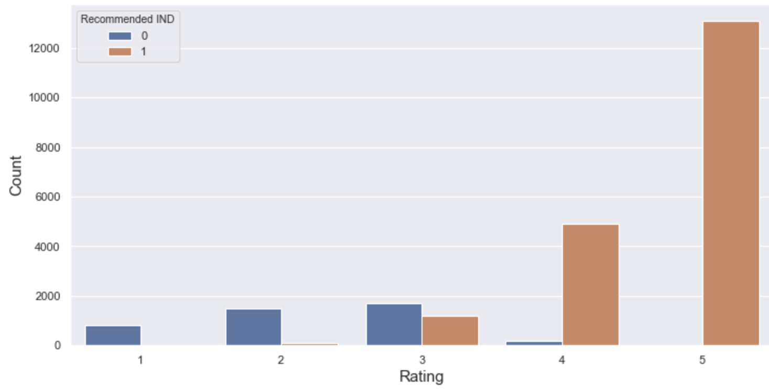
Methodology: Data Exploration
Bivariate Analysis
Recommended IND against rating and Department Name
Customers who gave the highest reviews have also recommended the product
Tops and Dresses department get the most items recommended

Slide 10
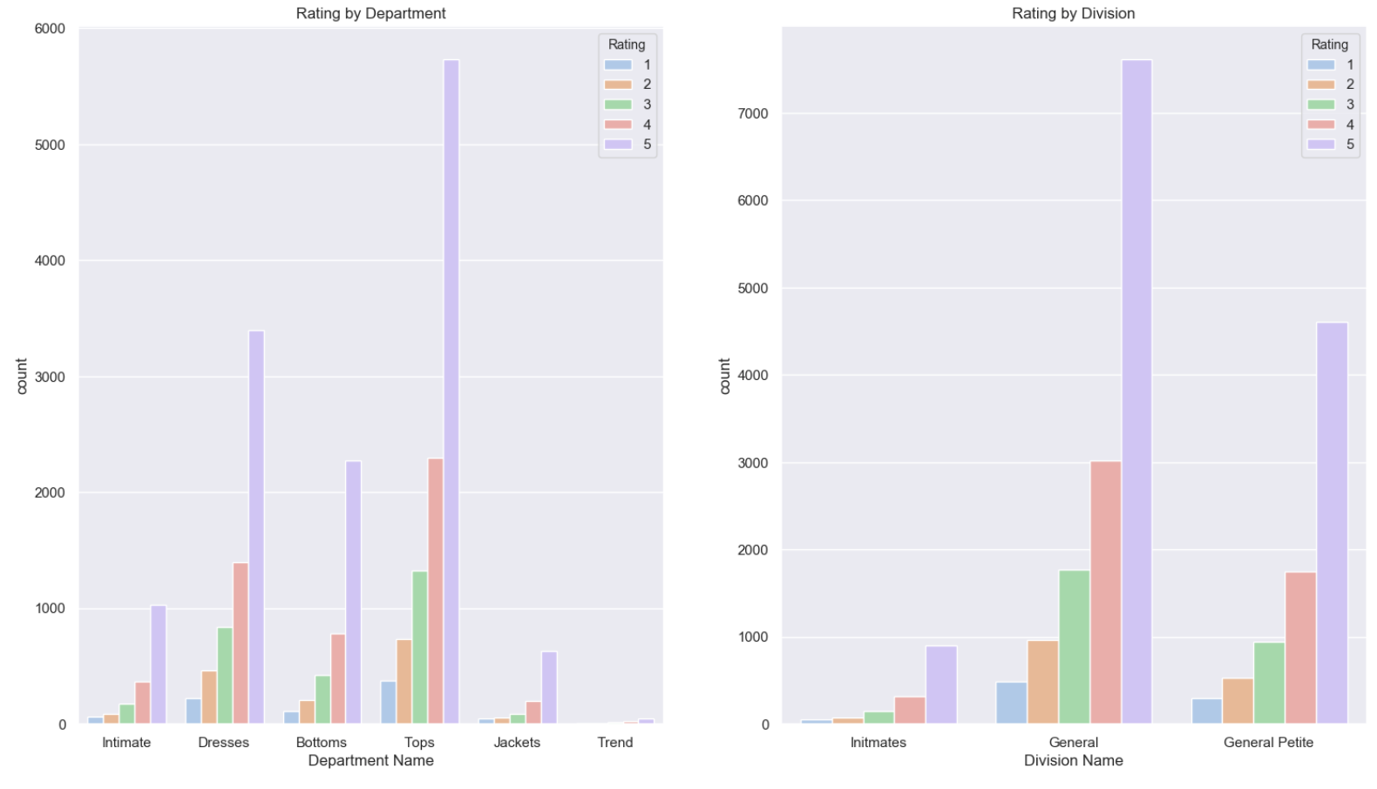
Methodology: Data Exploration
The above plot shows how much rating each department and division is getting. The ‘Tops’ and ‘Dresses’ departments get most of the 5-star ratings. In divisions, ‘General’ and ‘General Petite’ get most of the 5-star ratings

Slide 11
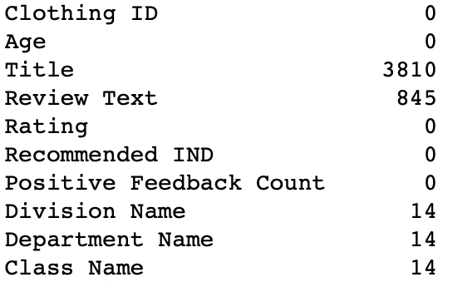
Methodology: Data Pre-processing
Checking for Missing Values
We removed these 4,697 missing values as they are reviews and categorical in nature

Slide 12
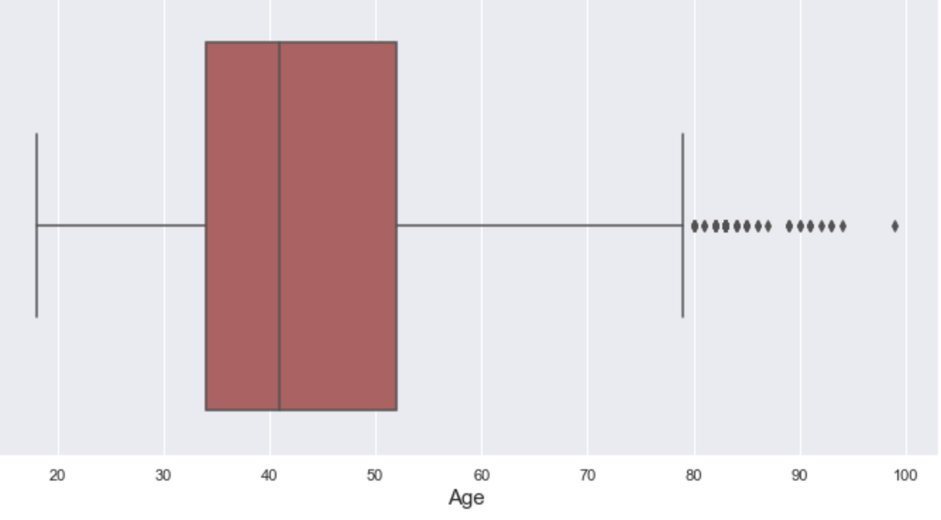
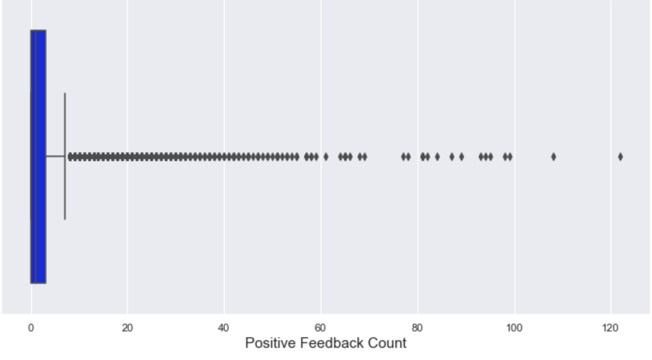
Methodology: Data Pre-processing
Outlier Detection
Median age in the dataset is around 40. However, we can see that age variable has a lot of outliers which go beyond the age of 80
Median feedback count is around 1. However, this variable has a lot of outliers

Slide 13
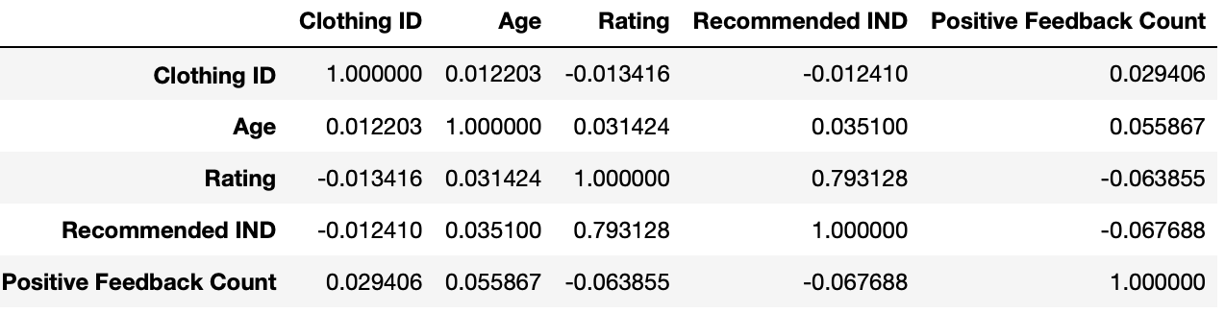
Methodology: Data Pre-processing
Removing Redundant Variables
There were no redundant variable in the dataset.
‘Rating’ is highly correlated with the target variable ‘Recommended IND”

Slide 14
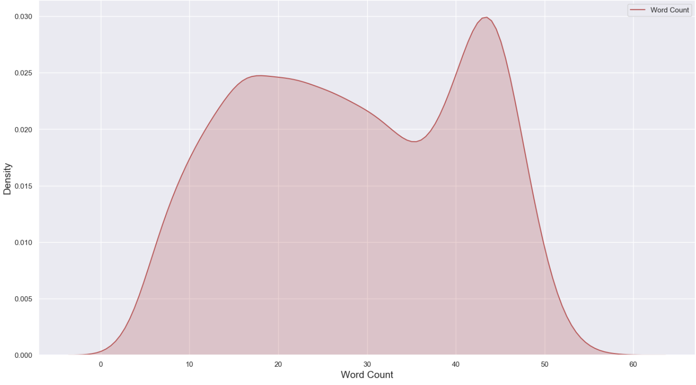
Methodology: Data Pre-processing
Text Cleaning
We leveraged ‘Spacy’ package to clean our dataset
After cleaning the dataset, following are the word count stats:
Total number of words in the cleaned reviews column: 551,280
Maximum number of words used in a review: 58

Slide 15
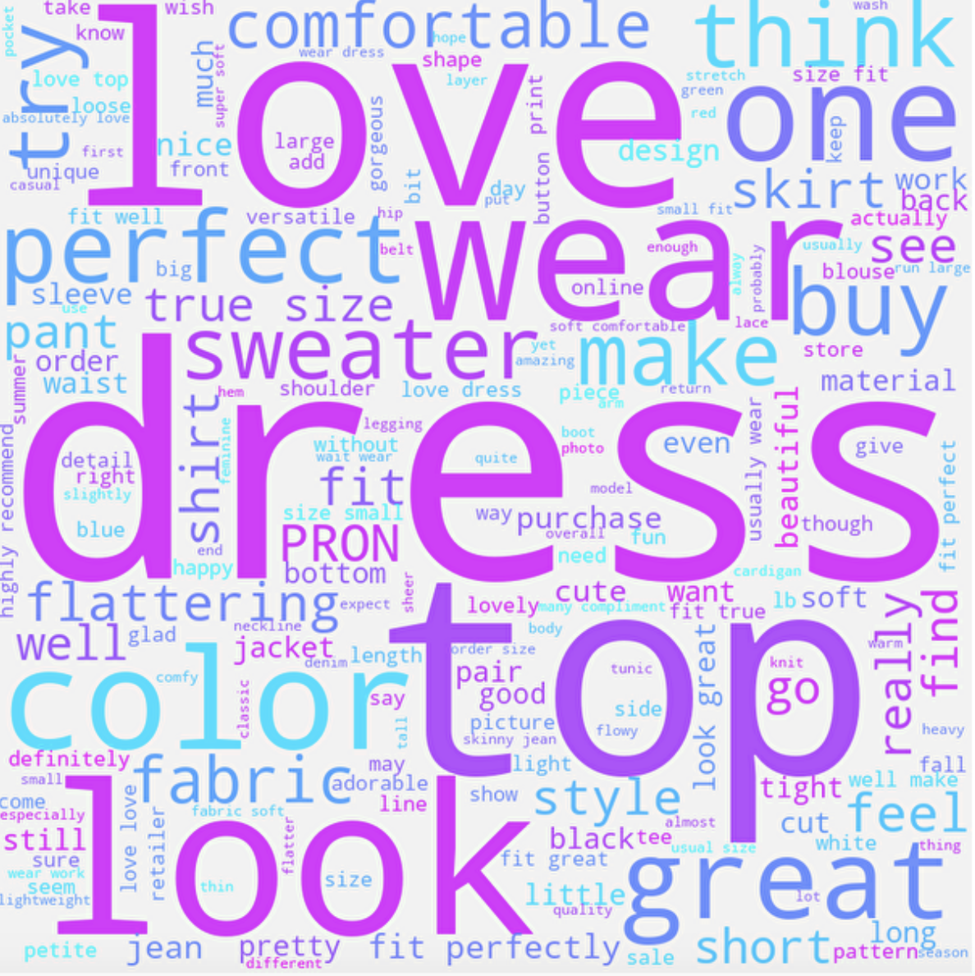
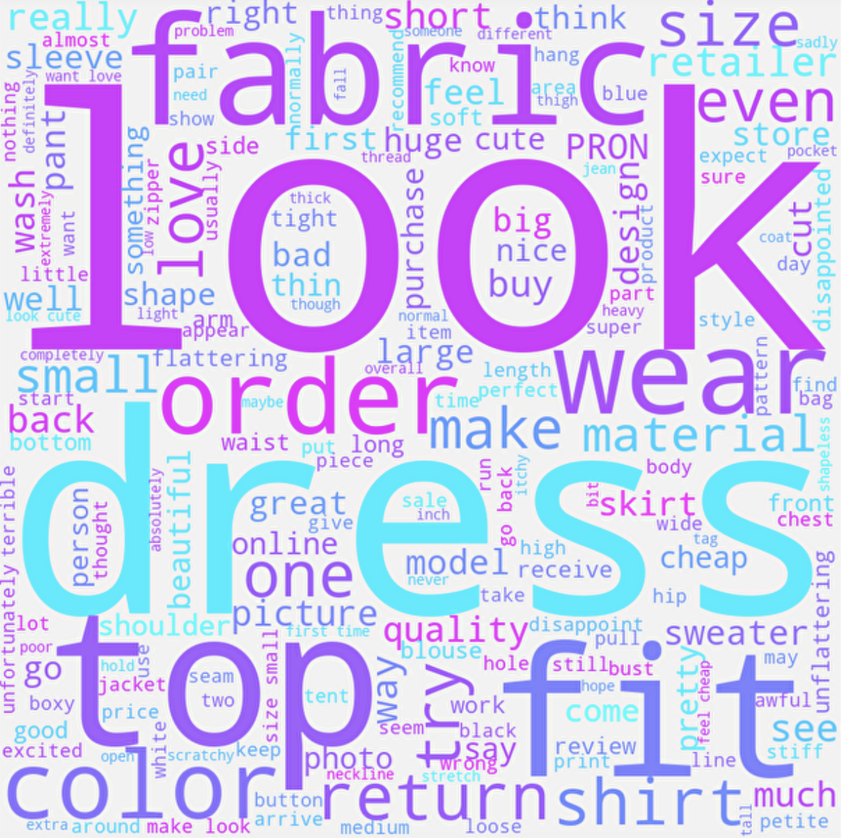
Methodology: Data Pre-processing
Most common words used for reviews
Rating 5
Rating 1
If we ignore common words like ‘dress’ and ‘look’, positive reviews with rating 5 had words like ‘love’, ‘color’. reviews with rating 1 had comments like ‘fabric’, ‘fit.

Slide 16
Methodology: Data Pre-processing
Sentiment Analysis
We used VADER package to conduct sentiment analysis on the dataset. VADER (Valence Aware Dictionary and sEntiment Reasoner) is a lexicon and rule-based sentiment analysis tool that is specifically attuned to sentiments expressed in social media.
VADER not only tells about the Positivity and Negativity score but also tells us about how positive or negative a sentiment is. The Compound score is a metric that calculates the sum of all the lexicon ratings which have been normalized between -1(most extreme negative) and +1 (most extreme positive) (Link).
Therefore, we have considered compound scores from 0 to 1 to reflect positive sentiment , equalling 0 as neutral and scores from -1 to 0 as negative.

Slide 17
Methodology: Data Pre-processing
Encoding Categorical Variables
After pre-processing the data, we selected the following 9 features for our analysis ['Age', 'Rating', 'Recommended IND', 'Positive Feedback Count', 'Division Name', 'Department Name', 'Class Name', 'Word Count', 'Sentiment’]
Based upon the correlation between these variables, we observe that ’Class Name_Jackets’ and ’Department Name_Jackets’ are highly correlated. We can remove one of them. Similarly for ‘Division Name_Initmates’ and ’Department Name_Intimate’, ‘Class Name_Dresses’ and ’Department Name_Dresses’ and ‘Department Name_Trend’ and ’Class Name_Trend’
Next, we created dummy variables for categorical variables like ’Division Name’, ‘Department Name’, ‘Class Name’ and ‘Sentiment’

Slide 18
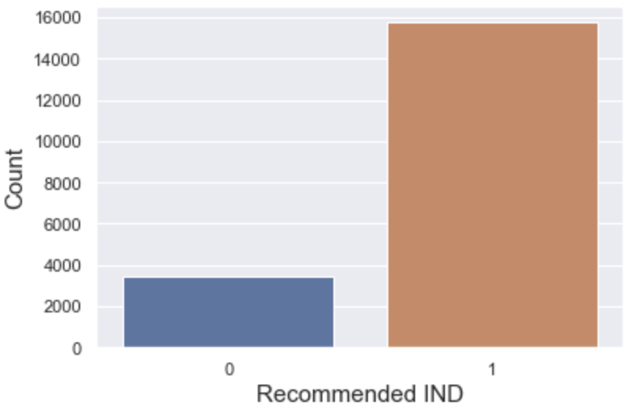
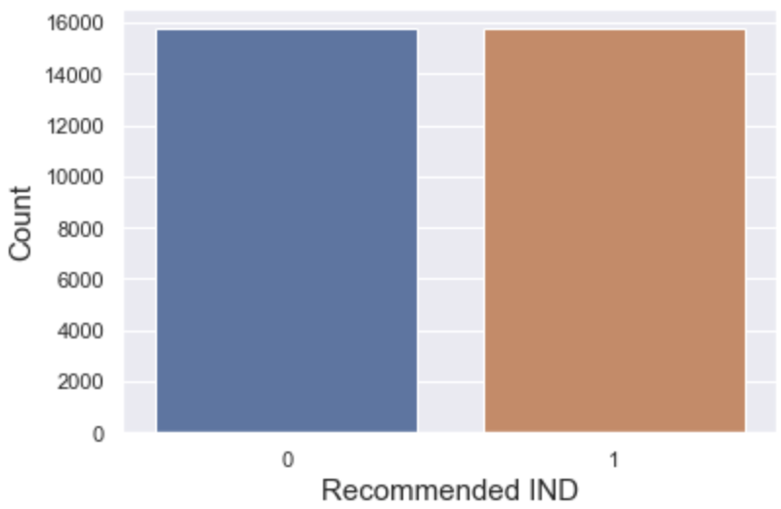
Methodology: Data Pre-processing
Balancing Dataset
We observe that there is class imbalance in our target variable which is ‘Recommended IND’. Therefore, if we run our analysis on this data, we might get biased results. To overcome this, we use SMOTE technique.

Slide 19
Classification Models
Methodology: Classification Model
Models | Accuracy | Precision | Recall | F1
Decision Tree Classifier | Test – 95% Train-95% | Test- 0.98 Train-0.98 | Test-0.92 Train-0.93 | Test-0.95 Train-0.95
Naïve Byes Classifier | Test-65% Train-66% | Test-0.86 Train-0.86 | Test-0.36 Train-0.38 | Test-0.51 Train-0.53
Logistics Regression | Test-95% Train-95% | Test-0.98 Train-0.98 | Test-0.92 Train-0.93 | Test-0.95 Train-0.95
SVM Classifier | Test-95% Train-95% | Test-0.98 Train-0.98 | Test-0.92 Train-0.93 | Test-0.95 Train-0.95

Slide 20
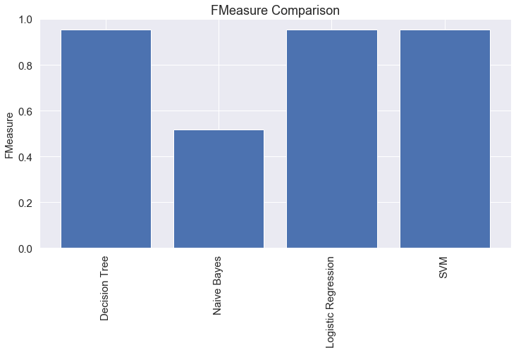
Conclusion
RESULTS:
On basis of accuracy and F-Measure we can infer that except Naïve Bayes all the classifier can be used to analyze the customer reviews.

Slide 21
Applications
The popular products
How many people are finding the reviews helpful
The reasons why a particular product is not recommended by customers
The product preference as per the age group
The correlation between ratings and the sentiment of the customer review
The expectations of customers

Slide 22
Limitations
The analysis mainly focuses on the reviews and ratings given by a customer and how it plays a role in their recommendation for that product. But there can be other reasons involved in the recommendation like sale details of the product like price, delivery date, quality( they would got something different from what they saw online). The lack of information on the impact of brand loyalty and brand likeliness affected by competition from other retailers as we do not have data about them as well.
The analysis could be improved if the products are segregated by sellers and particular products. Because this is real commercial data, it has been anonymized, and references to the company in the review text and body have been replaced with “retailer”. Including the price column will also be very helpful as mentioned.

Slide 23
Workload Distribution
Hemachandar Nagarajan: Model Classification
Sahibzada Aasim Imtiyaz: Sentiment Analysis
Ishita Kakar: Exploratory Data Analysis
Shailey Rai: Data Pre-Processing

